Slide 1
Storage Management Module 5.1

Slide 2
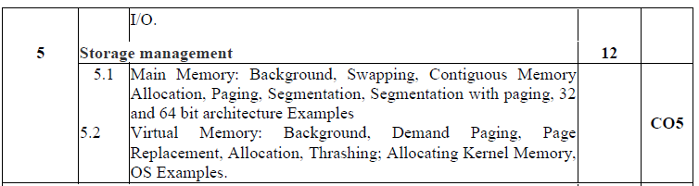

Slide 3
How do you differentiate?
Memory
Main memory
Physical Memory
RAM
Primary memory

Slide 4
Basics
Memory is central to operation of computing systems
Memory = a large array of words/bytes
Each byte or word has own address
Memory contains the program to be executed and data, both
Program is executed line by line with Instruction Fetch, Instruction Decode, Operand Fetch, Execute cycles
Program counter contains address of memory location to be executed next

Slide 5
Background
Memory consists of a large array of words or bytes, each with its own address.
The CPU fetches instructions from memory according to the value of the program counter. These instructions may cause additional loading from and storing to specific memory addresses.

Slide 6
Background
A typical instruction-execution cycle, for example,
first fetches an instruction from memory.
The instruction is then decoded and may cause operands to be fetched from memory.
After the instruction has been executed on the operands, results may be stored back in memory.
Memory unit only sees a stream of addresses + read requests, or address + data and write requests

Slide 7
Memory : hardware
CPU can directly access only main memory and processor registers
The instructions take main memory addresses as program arguments and not disk addresses
Hence- Data and instructions executing them, have to be in MM
Issues and concerns?
Speed of access : solution 🡺 cache memory
Protect program data : solution 🡺 base and limit registers
Size of memory : solution 🡺 swapping, virtual memory
Many more ones….

Slide 8
Basic Hardware
Register access in one CPU clock (or less)
Main memory access can take many cycles, causing a stall
Cache sits between main memory and CPU registers
Protection of memory required to ensure correct operation

Slide 9
Basic Hardware
Register access in one CPU clock (or less)
Main memory access can take many cycles, causing a stall
Cache sits between main memory and CPU registers
Protection of memory required to ensure correct operation
Registers that are built into the CPU are generally accessible within one cycle of the CPU clock.

Slide 10
Basic Hardware
Register access in one CPU clock (or less)
Main memory access can take many cycles, causing a stall
Cache sits between main memory and CPU registers
Protection of memory required to ensure correct operation
Main memory is accessed via a transaction on the memory bus.
Completing a memory access may take many cycles of the CPU clock.
In such cases, the processor normally needs to stall, since it does not have the data required to complete the instruction that it is executing

Slide 11
Speed of access
One of the Speed judgement parameters: number of CPU clock cycles needed to perform memory operation
CPU is a faster than memory
CPU registers are accessible in one CPU clock cycle
But MM is accessed via a transaction on memory bus
This access takes many CPU clocks to complete
Result? : CPU has program but not the data to complete instruction execution i.e. CPU stalling

Slide 12
Basic Hardware
Register access in one CPU clock (or less)
Main memory access can take many cycles, causing a stall
Cache sits between main memory and CPU registers
Protection of memory required to ensure correct operation
The remedy is to add fast memory between the CPU and main memory called cache.

Slide 13
Speed of access
As the data are needed always for instruction execution, frequent memory stalls are bottleneck
Solution : add a faster memory between CPU and main memory i.e. cache memory
Cache memory: a buffer to accommodate the speed difference

Slide 14
Basic Hardware
Register access in one CPU clock (or less)
Main memory access can take many cycles, causing a stall
Cache sits between main memory and CPU registers
Protection of memory required to ensure correct operation
Apart from relative speed of accessing physical memory, we also must ensure correct operation.
To protect the operating system from access by user processes
To protect user processes from one another. This protection must be provided by the hardware.

Slide 15
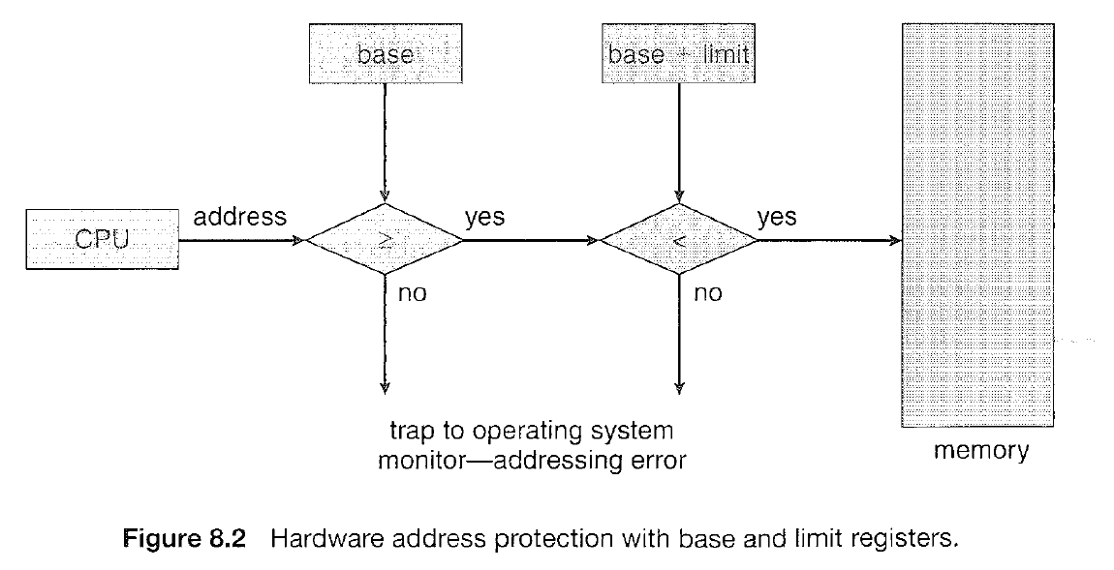
Access Protect
OS must be protected from unauthorized access by user process
User processes must be protected from each other
Each process has range of legal addresses to access
Base register and limit register ensure process can access only addresses within the legal range
Image courtesy: Galvin

Slide 16
Basic Hardware
We first need to make sure that each process has a separate memory space.
Determine the range of legal addresses that the process may access
To ensure that the process can access only these legal addresses.
We can provide this protection by using two registers, usually a base and a limit.

Slide 17
Base and Limit Registers
Base Register-Holds the smallest legal physical memory address
Limit Register- specifies the size of the range.

Slide 18
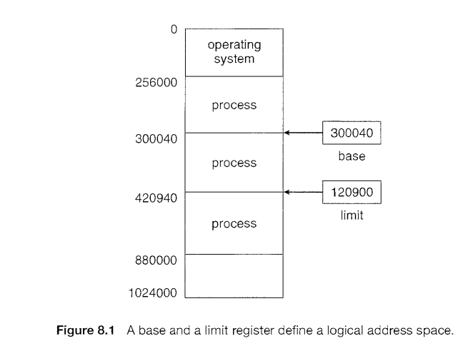
Base and Limit Registers
For example,
if the base register holds 300040
and the limit register is 120900,
then the program can legally access all addresses from 30 0040 through 420939 (inclusive).

Slide 19
Base and Limit Registers
Protection of memory space is accomplished by having the CPU hardware compare every address generated in user mode with the registers.
Any attempt by a program executing in user mode to access operating-system memory or other users' memory
Results in a trap to the operating system, which treats the attempt as a fatal error
This scheme prevents a user program from (accidentally or deliberately) modifying the code or data structures of either the operating system or other users.

Slide 20
Base and Limit Registers
CPU must check every memory access generated in user mode to be sure it is between base and limit for that user

Slide 21
Hardware Address Protection
The base and limit registers can be loaded only by the operating system, which uses a special privileged instruction.
Since privileged instructions can be executed only in kernel mode,
since only the operating system executes in kernel mode,
only the operating system can load the base and limit registers.
This scheme allows the operating system to change the value of the registers but prevents user programs from changing the registers' contents.

Slide 22
Hardware Address Protection
The operating system, executing in kernel mode, is given unrestricted access to both operating system memory and users' memory.
This provision allows the operating system
to load users' programs into users' memory,
to dump out those programs in case of errors

Slide 23
Address Binding
Usually, a program resides on a disk as a binary executable file.
To be executed, the program must be brought into memory and placed within a process.
Programs on disk, ready to be brought into memory to execute form an input queue
The normal procedure is to select one of the processes in the input queue and to load that process into memory.
As the process is executed, it accesses instructions and data from memory.
Eventually, the process terminates, and its memory space is declared available.

Slide 24
Address binding
User processes reside in any part of main memory
Computer address space starts at 00000
But user process need not be loaded at 00000
The program is processed by various system softwares before being executed such as macro processor, compiler, linker, loader etc..
User program addresses may be represented in various ways during these executions

Slide 25
Address binding.. contd
Addresses in source program are symbolic
Compiler binds symbolic addresses to relocatable addresses
E,g. 14 bytes from beginning of this module
The linker or loaders turn relocatable addresses to absolute addresses
Each such binding is mapping from one address space to another

Slide 26
Address Binding
Further, addresses represented in different ways at different stages of a program’s life
Source code addresses are usually symbolic (Eg-count)
A compiler will typically bind these symbolic addresses to relocatable addresses
i.e. “14 bytes from beginning of this module”
Linker or loader will bind relocatable addresses to absolute addresses
i.e. 74014
Each binding maps from one address space to another

Slide 27
Binding of Instructions and Data to Memory
The binding of instructions and data to memory addresses i.e.
Address binding of instructions and data to memory addresses can happen at three different stages
Compile time
Load time
Execution time

Slide 28
Binding instructions & data to memory
Can be done at any step during execution based on available info
If known at Compile time:
generates absolute code that resides at given memory.
Re-compile if the starting location changes
If known at Load time but not at compile time:
Generates relocatable code
Final binding is delayed until load time
If starting address changes, only reload the user code to incorporate the changed value
If known at Execution time
If process can be moved from one memory segment to another during execution
Binding is delayed until run time
Needs special hardware

Slide 29
Binding of Instructions and Data to Memory
Compile time:
If you know at compile time where the process will reside in memory, then absolute code can be generated.
If memory location known a priori,
For example, if you know that a user process will reside starting at location R, then the generated compiler code will start at that location and extend up from there.
Must recompile code if starting location changes-
If, at some later time, the starting location changes, then it will be necessary to recompile this code.

Slide 30
Binding of Instructions and Data to Memory
Load time:
Must generate relocatable code if memory location is not known at compile time
If it is not known at compile time where the process will reside in memory, then the compiler must generate relocatable code
In this case, final binding is delayed until load time.
If the starting address changes, we need only reload the user code to incorporate this changed value.

Slide 31
Binding of Instructions and Data to Memory
Execution time:
If the process can be moved during its execution from one memory segment to another, then binding must be delayed until run time.
Need hardware support for address maps (e.g., base and limit registers)

Slide 32
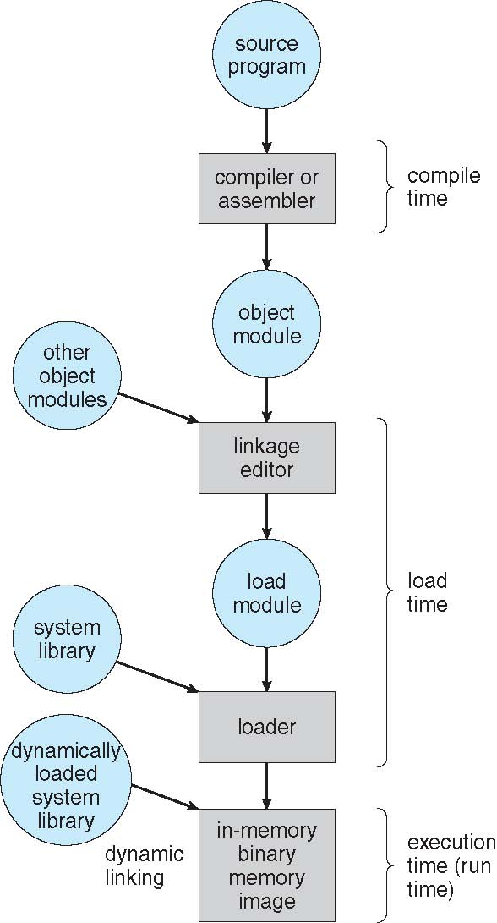
Multistep Processing of a User Program

Slide 33
Logical Vs physical address space
Logical address: An address generated by CPU
Physical address : an address loaded into memory address register of memory
The compile time and load time address-binding methods generate identical logical and physical address
But, execution time binding results in different logical and physical address space
Logical address space: set of all addresses generated by a program
Physical address space: set of all physical addresses corresponding to all logical addresses

Slide 34
Logical vs. Physical Address Space
Logical address –
An address generated by the CPU
also referred to as virtual address
Physical address –
Address seen by the memory unit
that is, the one loaded into memory address register of the memory
Logical address space- the set of all logical addresses generated by a program
Physical address space- the set of all physical addresses corresponding to these logical addresses

Slide 35
Logical vs. Physical Address Space
Logical and physical addresses are the same in compile-time and load-time address-binding schemes;
Logical (virtual) and physical addresses differ in execution-time address-binding scheme
Thus, in the execution-time address-binding scheme, the logical and physical address spaces differ.

Slide 36
Memory-Management Unit (MMU)
The run-time mapping from virtual to physical addresses is done by a hardware device called the MMU
Many methods possible for this mapping

Slide 37
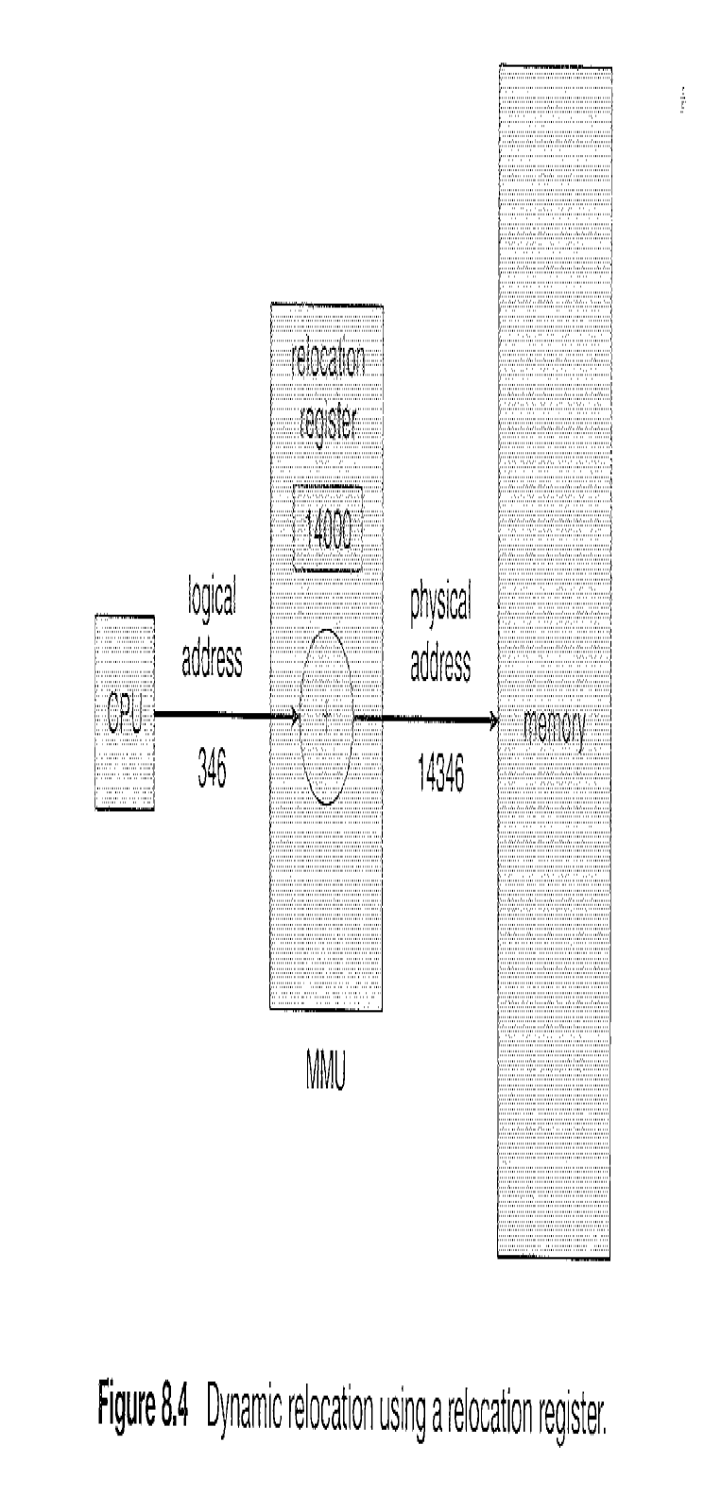
MMU
MMU (memory management unit) maps virtual addresses to physical addresses
Simple MMU scheme: generalization of base-register scheme
Base register is called relocation register
While sending to memory, relocation register value is added to every address generated by user process

Slide 38
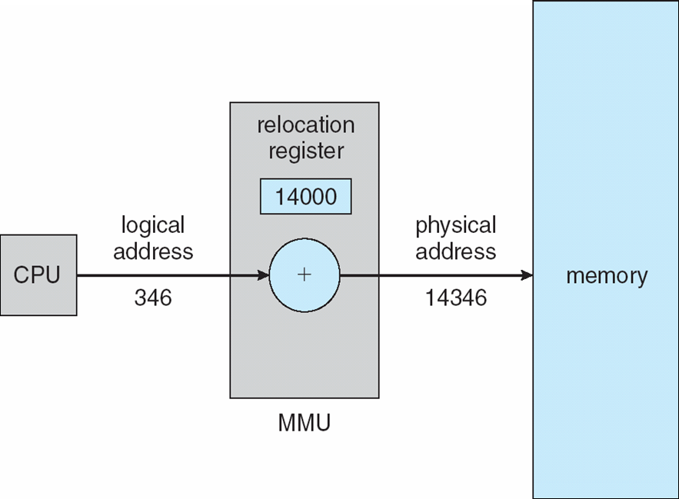
Memory-Management Unit (MMU)
To start, consider simple scheme –
Base register now called relocation register
The value in the relocation register is added to every address generated by a user process at the time it is sent to memory

Slide 39
Memory-Management Unit (MMU)
For example,
if the base is at 14000,
then an attempt by the user to address location 0 is dynamically relocated to location 14000;
an access to location 346 is mapped to location 14346.

Slide 40
The user program never sees the ‘real’ physical address.
User program deals with logical addresses
The memory mapping hardware converts logical addresses to physical addresses
Logical addresses: Range is 0 to max
Physical addresses: R+0 to R+max where R is base value

Slide 41
Dynamic Loading
So far:-
The entire program and all data of a process to be in physical memory for the process to execute.
The size of a process has thus been limited to the size of physical memory.

Slide 42
Dynamic Loading
To obtain better memory-space utilization,
we can use Dynamic Loading

Slide 43
Multistep Processing of a User Program

Slide 44
Dynamic Loading
Routine is not loaded until it is called
All routines kept on disk in relocatable load format
The main program is loaded into memory and is executed.
When a routine needs to call another routine, the calling routine first checks to see whether the other routine has been loaded.
If it has not, the relocatable linking loader is called to load the desired routine into memory and to update the program's address tables to reflect this change.
Then control is passed to the newly loaded routine.

Slide 45
Dynamic Loading
Advantage –
Unused routine is never loaded.
Useful when large amounts of code are needed to handle infrequently occurring cases. Eg- Error Routines
No special support from the operating system is required
Implemented through program design-
It is the responsibility of the users to design their programs to take advantage of such a method.
Operating systems may help the programmer,
by providing library routines to implement dynamic loading.

Slide 46
Dynamic Linking
Static linking –
System libraries and program code combined by the linker/loader into the binary program image
Dynamic linking –linking postponed until execution time

Slide 47
Dynamic Linking
Dynamic linking –
This feature is usually used with system libraries, such as language subroutine libraries.
Without this facility, each program on a system must include a copy of its language library (or at least the routines referenced by the program) in the executable image.
This requirement wastes both disk space and main memory.

Slide 48
Dynamic Linking
A stub is included in the image for each library routine reference.
The stub is a small piece of code that indicates how to locate the appropriate memory-resident library routine or how to load the library if the routine is not already present.

Slide 49
Dynamic Linking
When the stub is executed,
It checks to see whether the needed routine is already in memory.
If it is not, the program loads the routine into memory.
Either way, the stub replaces itself with the address of the routine and executes the routine.
Thus, the next time that particular code segment is reached, the library routine is executed directly, incurring no cost for dynamic linking.

Slide 50
Dynamic Linking
This feature can be extended to library updates (such as bug fixes).
A library may be replaced by a new version,
All programs that reference the library will automatically use the new version. Without dynamic linking, all such programs would need to be relinked to gain access to the new library.

Slide 51
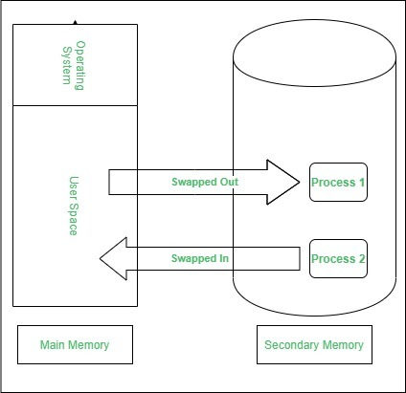
Swapping
Swapping is a process of swapping a process temporarily to a secondary memory from the main memory

Slide 52
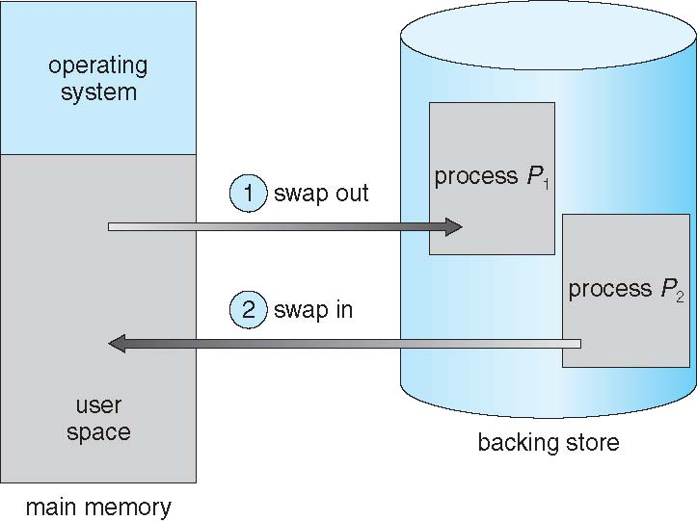
Swapping
A process can be swapped temporarily out of memory to a backing store, and then brought back into memory for continued execution

Slide 53
Swapping
Backing store –
fast disk large enough to accommodate copies of all memory images for all users;
must provide direct access to these memory images

Slide 54
Swapping
Q
MMU /Dispatcher
For example,
Assume a multiprogramming environment with a round-robin CPU-scheduling algorithm.
When a quantum expires, the memory manager will start to swap out the process that just finished and to swap another process into the memory space that has been freed
In the meantime, the CPU scheduler will allocate a time slice to some other process in memory.
When each process finishes its quantum, it will be swapped with another process.
Ideally, the memory manager can swap processes fast enough that some processes will be in memory, ready to execute, when the CPU scheduler wants to reschedule the CPU.

Slide 55
Swapping
Roll out, roll in –
A variant of this swapping policy is used for priority-based scheduling algorithms.
If a higher-priority process arrives and wants service,
The memory manager can swap out the lower-priority process and then load and execute the higher-priority process.
When the higher-priority process finishes, the lower-priority process can be swapped back in and continued.
This variant of swapping is sometimes called roll out, roll in.

Slide 56
Swapping
Major part of swap time is transfer time;
total transfer time is directly proportional to the amount of memory swapped
System maintains a ready queue of ready-to-run processes which have memory images on disk

Slide 57
Swapping (Cont.)
Does the swapped out process need to swap back in to same physical addresses?

Slide 58
Swapping
Normally, a process that is swapped out will be swapped back into the same memory space it occupied previously.
The restriction is dictated by the method of address binding.
If binding is done at assembly/Compile or load time, then the process cannot be easily moved to a different location.
if execution time binding is being used, then a process can be swapped into a different memory space as the physical addresses are computed at execution time

Slide 59
Dispatcher and swapper
Swapping requires a backing store.
The backing store is commonly a fast disk, large enough to accommodate copies of all memory images for all users
Provides direct access to these memory images.
The system maintains a ready queue of all processes whose memory images are in memory and are ready to run.
Whenever the CPU scheduler decides to execute a process, it calls the dispatcher.
The dispatcher checks to see whether the next process in the queue is in memory.
If it is not, and if there is no free memory region, the swapper swaps out a process currently in memory and swaps in the desired process.
It then reloads registers and transfers control to the selected process.

Slide 60
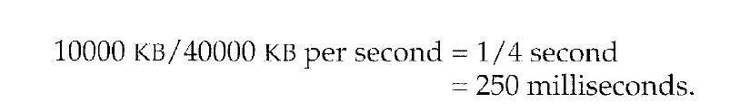
The context-switch time in such a swapping system is fairly high.
Assume a user process of 10 MB size and the backing store is a standard hard disk with a transfer rate of 40 MB per second. The actual transfer of the 10-MB process to or from main memory takes:
Assuming that no head seeks are necessary, and assuming an average latency of 8 milliseconds, the swap time is 258 milliseconds.
Considering both swap out and swap in, the total swap time = 516 milliseconds.
For efficient CPU utilization, the execution time for each process should be long relative to the swap time.
Thus, in a round-robin CPU-scheduling algorithm, for example, the time quantum should be substantially larger than 0.516 seconds.

Slide 61
Swapping (Cont.)
Modified versions of swapping are found on many systems (i.e., UNIX, Linux, and Windows)
Swapping normally disabled
Started if more than threshold amount of memory allocated
Disabled again once memory demand reduced below threshold

Slide 62
Schematic View of Swapping

Slide 63
Contiguous Allocation
Main memory must support both OS and user processes
Limited resource, must allocate efficiently
Contiguous allocation per process is one early method

Slide 64
Memory allocation to OS and User programs
The main memory must accommodate both the operating system and the various user processes.
Hence, OS needs to allocate the parts of the main memory in the most efficient way possible.
The memory is divided into two partitions:
For the resident operating system and
For the user processes.
So the operating system in either low memory or high memory.
The major factor affecting this decision is the location of the interrupt vector.
Since the interrupt vector is often in low memory, programmers usually place the operating system in low memory as well.
User processes then held in high memory

Slide 65
Contiguous Allocation
In contiguous memory allocation, each process is contained in a single contiguous section of memory.

Slide 66
Memory Mapping and Protection
To protect user processes from each other, and from changing operating-system code and data by using a relocation register together with a limit register.
The relocation register contains the value of the smallest physical address
The limit register contains the range of logical addresses – each logical address must be less than the limit register

Slide 67
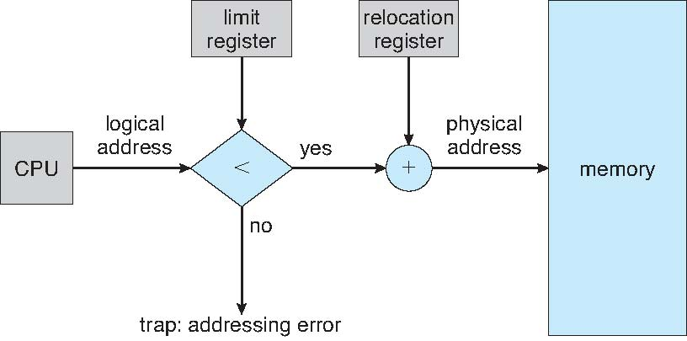
Memory Mapping and Protection
Each logical address must be less than the limit register;
The MMU maps the logical address dynamically by adding the value in the relocation register.
This mapped address is sent to memory
(for example, relocation= 100040 and limit= 74600).

Slide 68
Hardware Support for Relocation and Limit Registers

Slide 69
Types of Memory Management Techniques
Contiguous
Non-Contiguous

Slide 70
In Contiguous Technique, executing process must be loaded entirely in the main memory.
The contiguous Technique can be divided into:
Fixed (or static) partitioning
Variable (or dynamic) partitioning

Slide 71
Fixed partitioning
Also known as static partitioning,
No of Partitions are fixed
In this partitioning, the number of partitions (non-overlapping) in RAM is fixed but the size of each partition may or may not be the same.

Slide 72
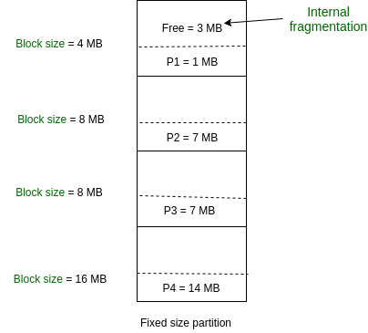
Fixed partitioning
Is a memory allocation technique used in operating systems to divide the physical memory into fixed-size partitions or regions, each assigned to a specific process or user.
Partitions are made before execution or during system configure.
Each partition remains dedicated to a specific process until it terminates or releases the partition.

Slide 73
Fixed partitioning
Disadvantages:
It can lead to internal fragmentation, where memory in a partition remains unused. This can happen when the process’s memory requirements are smaller than the partition size, leaving some memory unused

Slide 74
Variable (or Dynamic) Partitioning
In contrast with fixed partitioning, partitions are not made before the execution or during system configuration.
No of partitions are not fixed

Slide 75
Variable (or Dynamic) Partitioning
Features:
Initially, RAM is empty and partitions are made during the run-time according to the process’s need instead of partitioning during system configuration.
The size of the partition will be equal to the incoming process.
The partition size varies according to the need of the process so that internal fragmentation can be avoided to ensure efficient utilization of RAM.
The number of partitions in RAM is not fixed and depends on the number of incoming processes and the Main Memory’s size.

Slide 76
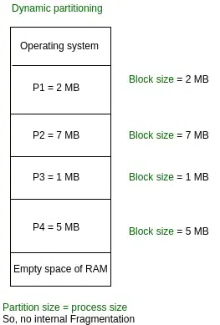
Variable (or Dynamic) Partitioning

Slide 77
Non-Contiguous Memory Allocation
In this technique, each process is allocated a series of non-contiguous blocks of memory that can be located anywhere in the physical memory.
Paging and Segmentation are the two ways that allow a process’s physical address space to be non-contiguous. It has the advantage of reducing memory wastage but it increases the overheads due to address translation. It slows the execution of the memory because time is consumed in address translation.

Slide 78
Memory Allocation-Fixed Size Partitions
One of the simplest methods for allocating memory is –
To divide memory into several fixed-sized partitions.
Each partition may contain exactly one process.
Thus, the degree of multiprogramming is bound by the number of partitions.
In this Multiple partition method, when a partition is free, a process is selected from the input queue and is loaded into the free partition.
When the process terminates, the partition becomes available for another process.
This method was originally used by the IBM OS/360 operating system (called MFT); it is no longer in use.

Slide 79
Memory Allocation
In the Variable Partition scheme,
The operating system keeps a table indicating which parts of memory are available and which are occupied.
Initially, all memory is available for user processes and is considered one large block of available memory-a Hole.
Eventually as you will see, memory contains a set of holes of various sizes.
“Hole – block of available memory; holes of various size are scattered throughout memory”

Slide 80
Memory Allocation-Fixed Size Partitions
As processes enter the system, they are put into an input queue.
At any given time, then, we have a list of available block sizes and an input queue.
The operating system can order the input queue according to a scheduling algorithm.
Process selected from input queue is allocated memory from a hole large enough to accommodate it
The operating system can wait until a large enough block is available,
or it can skip down the input queue to see whether the smaller memory requirements of some other process can be met.

Slide 81
Memory Allocation-Fixed Size Partitions
The memory blocks available comprise a set of holes of various sizes scattered throughout memory.
When a process arrives and needs memory, the system searches the set for a hole that is large enough for this process.
If the hole is too large, it is split into two parts.
One part is allocated to the arriving process;
the other is returned to the set of holes.

Slide 82
Memory Allocation-Fixed Size Partitions
When a process terminates, it releases its block of memory, which is then placed back in the set of holes.
If the new hole is adjacent to other holes, these adjacent holes are merged to form one larger hole.
At this point, the system may need to check whether there are processes waiting for memory and whether this newly freed and recombined memory could satisfy the demands of any of these waiting processes.

Slide 83
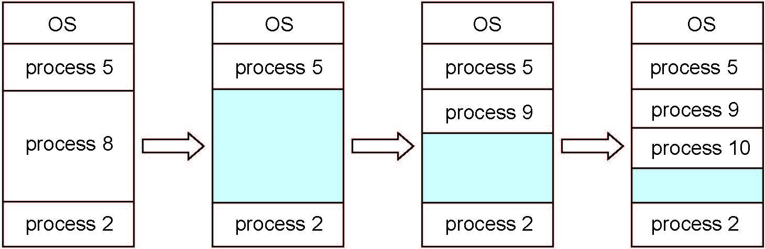
Multiple-partition allocation
Variable-partition sizes for efficiency (sized to a given process’ needs)
Hole – block of available memory; holes of various size are scattered throughout memory
When a process arrives, it is allocated memory from a hole large enough to accommodate it
Process exiting frees its partition, adjacent free partitions combined
Operating system maintains information about: a) allocated partitions b) free partitions (hole)

Slide 84
Dynamic Storage-Allocation Problem
How to satisfy a request of size n from a list of free holes?
First-fit
Best-fit
Worst-fit

Slide 85
Dynamic Storage-Allocation Problem
How to satisfy a request of size n from a list of free holes?
First-fit:
Allocate the first hole that is big enough
Searching can start either at the beginning of the set of holes or at the location where the previous first-fit search ended.
We can stop searching as soon as we find a free hole that is large enough.

Slide 86
Dynamic Storage-Allocation Problem
How to satisfy a request of size n from a list of free holes?
Best-fit:
Allocate the smallest hole that is big enough;
We must search entire list, unless ordered by size
This strategy produces the smallest leftover hole

Slide 87
Dynamic Storage-Allocation Problem
How to satisfy a request of size n from a list of free holes?
Worst-fit:
Allocate the largest hole;
We must also search entire list unless it is sorted by size.
This strategy produces the largest leftover hole which may be more useful than the smaller leftover hole from a best-fit approach.

Slide 88
Dynamic Storage-Allocation Problem
Simulations have shown that
Both first fit and best fit are better than worst fit in terms of decreasing time and storage utilization.
Neither first fit nor best fit is clearly better than the other in terms of storage utilization, but first fit is generally faster.

Slide 89
Dynamic Storage-Allocation Problem
How to satisfy a request of size n from a list of free holes?
First-fit: Allocate the first hole that is big enough
Best-fit: Allocate the smallest hole that is big enough; must search entire list, unless ordered by size
Produces the smallest leftover hole
Worst-fit: Allocate the largest hole; must also search entire list
Produces the largest leftover hole
First-fit and best-fit better than worst-fit in terms of speed and storage utilization

Slide 90
Fragmentation
As processes are loaded and removed from memory, the free memory space is broken into little pieces

Slide 91
Fragmentation
Memory fragmentation can be-
External Fragmentation
Internal Fragmentation

Slide 92
Fragmentation
External Fragmentation –
Total memory space exists to satisfy a request, but it is not contiguous
Storage is fragmented into a large number of small holes.
This fragmentation problem can be severe
In the worst case,
A block of free (or wasted) memory between every two processes.
If all these small pieces of memory were in one big free block instead, we might be able to run several more processes.

Slide 93
Fragmentation
Internal Fragmentation –
Allocated memory may be slightly larger than requested memory;
This size difference is memory internal to a partition, but not being used
Unused Memory Internal to a partition

Slide 94
Fragmentation
Internal Fragmentation –
Consider a multiple-partition allocation scheme with a hole of 18,464 bytes.
Suppose that the next process requests 18,462 bytes.
If we allocate exactly the requested block,
We are left with a hole of 2 bytes.

Slide 95
Fragmentation
First fit analysis reveals that given N blocks allocated, 0.5 N blocks lost to fragmentation
1/3 may be unusable -> 50-percent rule

Slide 96
Fragmentation (Cont.)
Reduce external fragmentation by compaction
Shuffle memory contents to place all free memory together in one large block
Compaction is possible only if relocation is dynamic, and is done at execution time
If addresses are relocated dynamically, relocation requires only moving the program and data and then changing the base register to reflect the new base address.

Slide 97
Fragmentation (Cont.)
The simplest compaction algorithm is
To move all processes toward one end of memory;
all holes move in the other direction,
producing one large hole of available memory.
This scheme can be expensive.

Slide 98
Fragmentation (Cont.)
Another possible solution-
To permit the logical address space of the processes to be non contiguous,
thus allowing a process to be allocated physical memory wherever such memory is available.

Slide 99
Non-Contiguous Memory Allocation
In this technique, each process is allocated a series of non-contiguous blocks of memory that can be located anywhere in the physical memory.
Paging and Segmentation are the two ways that allow a process’s physical address space to be non-contiguous. It has the advantage of reducing memory wastage but it increases the overheads due to address translation. It slows the execution of the memory because time is consumed in address translation.

Slide 100
Paging
Paging is a memory-management scheme that permits the physical address space of a process to be non-contiguous
Process is allocated physical memory whenever the latter is available
Avoids external fragmentation and the need for compaction
Avoids problem of varying sized memory chunks

Slide 101
Paging
Divide physical memory into fixed-sized blocks called frames
Size is power of 2, between 512 bytes and 16 Mbytes
Divide logical memory into blocks of same size called pages
Keep track of all free frames
To run a program of size N pages, need to find N free frames and load program
Set up a page table to translate logical to physical addresses
Backing store likewise split into pages
Still have Internal fragmentation

Slide 102
Address Translation Scheme
Address generated by CPU is divided into:
Page number (p) – used as an index into a page table
The Page table contains the base address of each page in physical memory
Page offset (d) – combined with base address to define the physical memory address that is sent to the memory unit

Slide 103
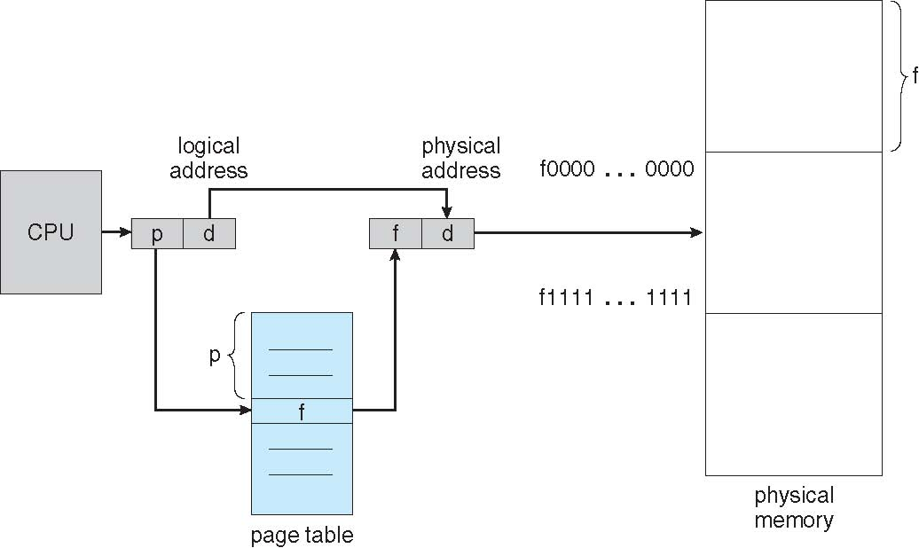
Paging Hardware

Slide 104
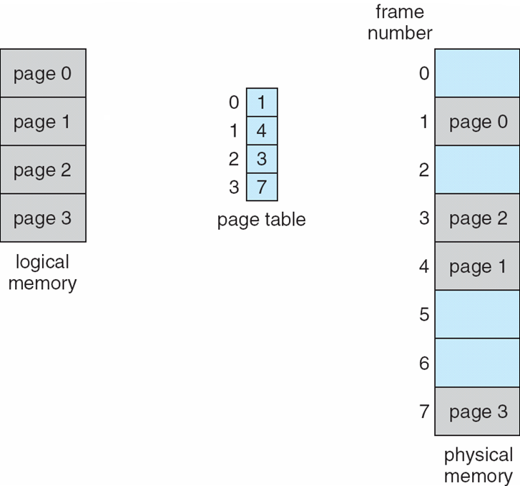
Paging Model of Logical and Physical Memory

Slide 105
Paging (Cont.)
The page size (like the frame size) is defined by the hardware.
The size of a page is typically a power of 2,
Varying between 512 bytes and 16 MB per page, depending on the computer architecture.
The selection of a power of 2 as a page size makes the translation of a logical address into a page number and page offset particularly easy.

Slide 106
Paging (Cont.)
If the size of the logical address space = 2^{m}, and
a page size = 2^{n} addressing units (bytes or words)
then the high-order m- n bits of a logical address designate the page number,
the n low-order bits designate the page offset.
where p is an index into the page table and
d is the displacement within the page.
For given logical address space 2^{m} and page size 2^{n}

Slide 107
Paging (Cont.)
In the logical address, n= 2 and m = 4
If the size of the logical address space = 2^{m}, = 2⁴ and
So, a page size = 2^{n} addressing units (bytes or words) = 2² bytes
Using a page size of 4 bytes and a physical memory of 32 bytes (8 pages),
We show how the user's view of memory can be mapped into physical memory

Slide 108
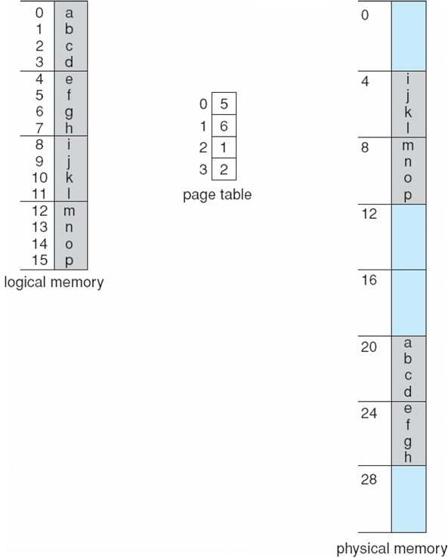
Paging Example
Frames
Logical address 0 is page 0, offset 0. Indexing into the page table, we find that page 0 is in frame 5.
Thus, logical address 0 maps to physical address 20 [= (5 x 4) + 0].
*Using a page size of 4 bytes
0
1
2
3
4
5
6
7
n=2 and m=4 32-byte memory and 4-byte pages

Slide 109
Paging Example
Frames
Logical address 3 (page 0, offset 3),
we find that page 0 is in frame 5,
maps to physical address 23 [ = (5 x 4) + 3].
Logical address 4 is page 1, offset 0; according to the page table, page 1 is mapped to frame 6. Thus, logical address 4 maps to physical address 24 [ = ( 6 x 4) + O].
Logical address 13 ( page 3, offset 1) according to the page table, page 3 is mapped to frame 2. Thus, logical address 4 maps to physical address 9 [ = ( 2 x 4) + 1].
0
1
2
3
4
5
6
7
n=2 and m=4 32-byte memory and 4-byte pages

Slide 110
Paging (Cont.)
When we use a paging scheme,
We have no external fragmentation: any free frame can be allocated to a process that needs it.
We may have some internal fragmentation.

Slide 111
Paging (Cont.)
Calculating internal fragmentation
Page size = 2,048 bytes
Process size = 72,766 bytes
35 pages + 1,086 bytes
Internal fragmentation of 2,048 - 1,086 = 962 bytes
Worst case fragmentation
A process would needs n pages plus 1 byte. It
would be allocated n+ 1 frames
resulting in internal fragmentation of almost an entire frame.

Slide 112
Paging (Cont.)
Process view and physical memory now very different
By implementation process can only access its own memory

Slide 113
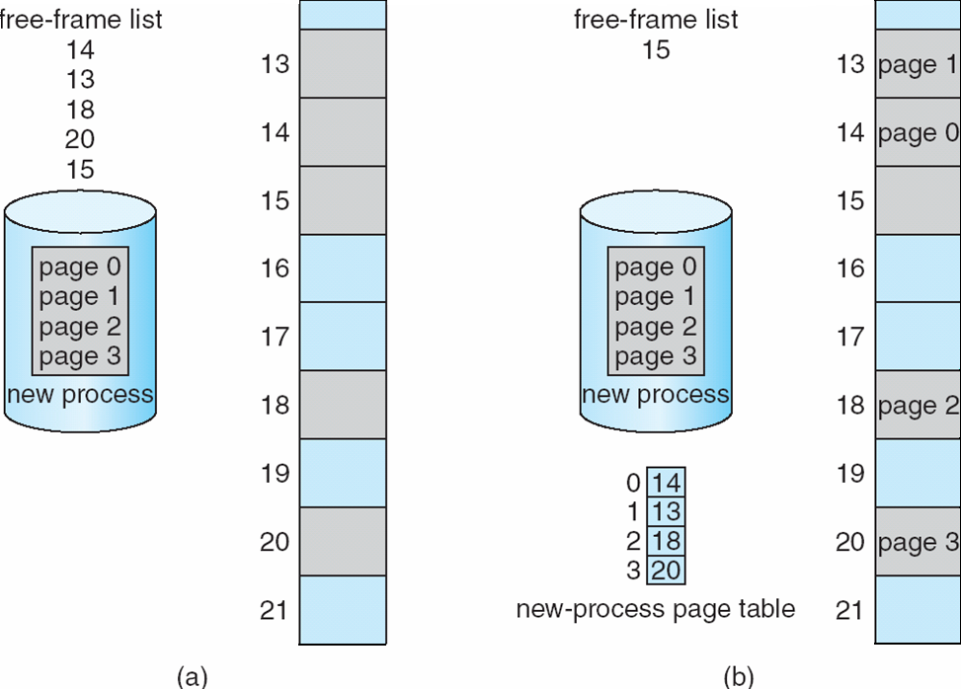
Free Frames
Before allocation
After allocation

Slide 114
Free Frames
When a process arrives in the system to be executed, its size, expressed in pages, is examined.
Each page of the process needs one frame.
Thus, if the process requires n pages, at least n frames must be available in memory.
After allocation
Before allocation

Slide 115
Free Frames
If n frames are available, they are allocated to this arriving process.
The first page of the process is loaded in one of the allocated frames,
The frame number is put in the page table for this process.
The next page is loaded into another frame, its frame number is put into the page table, and so on
After allocation
Before allocation

Slide 116
Paging
An important aspect of paging
Clear separation between the user's view of memory and the actual physical memory.
The user program views memory as one single space, containing only this one program.
In fact, the user program is scattered throughout physical memory, which also holds other programs.

Slide 117
Paging
The difference between the user's view of memory and the actual physical memory is reconciled by the address-translation hardware.
The logical addresses are translated into physical addresses.
This mapping is hidden from the user and is controlled by the operating system.

Slide 118
Hardware Support
Each operating system has its own methods for storing page tables.
Most allocate a page table for each process.
A pointer to the page table is stored with the other register values (like the instruction counter) in the process control block.
When the dispatcher is told to start a process, it must reload the user registers and define the correct hardware page-table values from the stored user page table.
PCB-Module 2

Slide 119
Implementation of Page Table
The hardware implementation of the page table can be done in several ways.
In the simplest case, the page table is implemented as a set of dedicated registers.
These registers should be built with very high-speed logic to make the paging-address translation efficient.
The use of registers for the page table is satisfactory if the page table is reasonably small (for example, 256 entries).
Most contemporary computers, however, allow the page table to be very large (for example, 1 million entries).
For these machines, the use of fast registers to implement the page table is not feasible.

Slide 120
Implementation of Page Table
Page table is kept in main memory
Page-table base register (PTBR) points to the page table
Changing page tables requires changing only this one register
Page-table length register (PTLR) indicates size of the page table
In this scheme every data/instruction access requires two memory accesses
One for the page table and one for the data / instruction
The two memory access problem can be solved by the use of a special fast-lookup hardware cache called associative memory or translation look-aside buffers (TLBs)

Slide 121
What is TLB?
Use of a special fast-lookup hardware cache called associative memory or translation look-aside buffers (TLBs)
The TLB is associative, high-speed memory.
Each entry in the TLB consists of two parts:
A key (or tag) and a value.

Slide 122
What is TLB?
When the associative memory is presented with an item,
The item is compared with all keys simultaneously. If the item is found, the corresponding value is returned.
The search is fast; the hardware, however, is expensive.
Typically, the number of entries in a TLB is small, often numbering between 64 and 1,024.

Slide 123
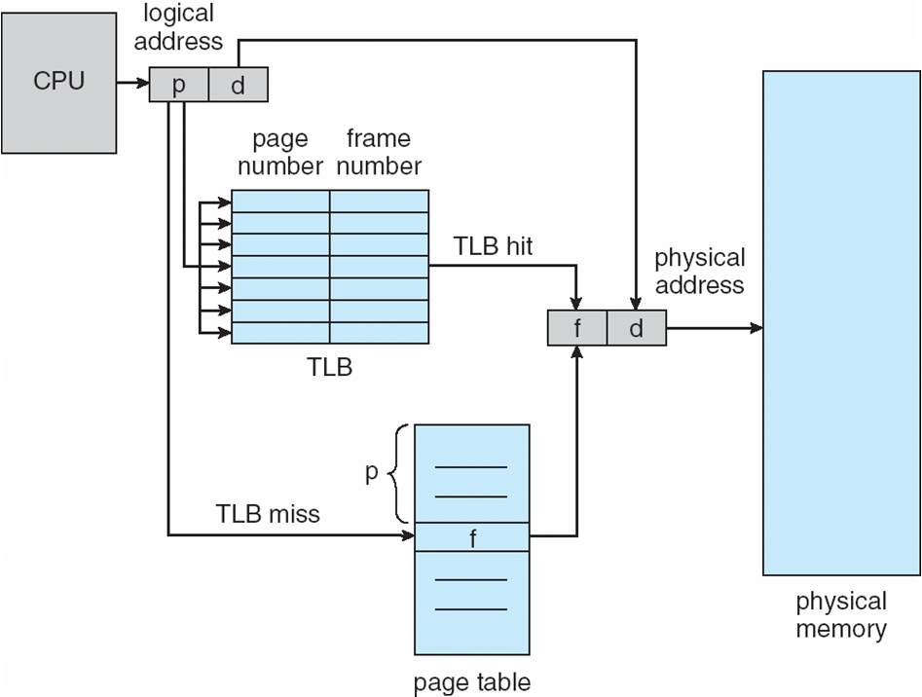
How does TLB work?
The TLB contains only a few of the page-table entries.
When a logical address is generated by the CPU, its page number is presented to the TLB.
If the page number is found,
=TLB Hit, Its frame number is immediately available and is used to access memory.

Slide 124
How does TLB work?
If the page number is not in the TLB
=TLB miss,
Reference to the page table must be made.
When the frame number is obtained, we can use it to access memory .
In addition, we add the page number and frame number to the TLB, so that they will be found quickly on the next reference.

Slide 125
How does TLB work?
If the TLB is already full of entries, the operating system must select one for replacement.
Replacement policies range from least recently used (LRU) to random.

Slide 126
Associative Memory
Associative memory – parallel search
Address translation (p, d)
If p is in associative register, get frame # out
Otherwise get frame # from page table in memory

Slide 127
Paging Hardware With TLB

Slide 128
Implementation of Page Table (Cont.)
Some TLBs store address-space identifiers (ASIDs) in each TLB entry –
An ASID Uniquely identifies each process and provides address-space protection for that process
When the TLB attempts to resolve virtual page numbers, it ensures that the ASID for the currently running process matches the ASID associated with the virtual page.
If the ASIDs do not match, the attempt is treated as a TLB miss.
In addition to providing address-space protection, an ASID allows the TLB to contain entries for several different processes simultaneously.

Slide 129
Effective Access Time
Hit Ratio=The percentage of times that a particular page number is found in the TLB
An 80-percent hit ratio, for example, means that we find the desired page number in the TLB 80 percent of the time.
TLB Hit-
If it takes 20 nanoseconds to search the TLB and 100 nanoseconds to access memory, then a mapped-memory access takes 120 nanoseconds
TLB Miss-
If we fail to find the page number in the TLB (20 nanoseconds), then we must first access memory for the page table and frame number (100 nanoseconds) and then access the desired byte in memory (100 nanoseconds), for a total of 220 nanoseconds.

Slide 130
Effective Access Time
To find the effective memory access time,
Effective access time = 0.80 x 120 + 0.20 x 220
= 140 nanoseconds.

Slide 131
Effective Access Time
To find the effective memory access time,
For a 98-percent hit ratio,
Effective access time = 0.98 x 120 + 0.02 x 220
= 122 nanoseconds.

Slide 132
Effective Access Time
Associative Lookup = ε time unit
Can be < 10% of memory access time
Hit ratio = α
Hit ratio – percentage of times that a page number is found in the associative registers; ratio related to number of associative registers
Consider α = 80%, ε = 20ns for TLB search, 100ns for memory access
Effective Access Time (EAT)
EAT = (1 + ε) α + (2 + ε)(1 – α)
= 2 + ε – α

Slide 133
Memory Protection
Memory protection implemented by associating protection bit with each frame
Normally, these bits are kept in the page table.
Protection bit can indicate if read-only or read-write access is allowed

Slide 134
Memory Protection
Every reference to memory goes through the page table to find the correct frame number.
At the same time that the physical address is being computed, the protection bits can be checked to verify that no writes are being made to a read-only page.
An attempt to write to a read-only page causes a hardware trap to the operating system (or memory-protection violation).

Slide 135
Memory Protection
Can also add more bits to indicate page execute-only, and so on
Valid-invalid bit attached to each entry in the page table:
“valid” indicates that the associated page is in the process’ logical address space, and is thus a legal page
“invalid” indicates that the page is not in the process’ logical address space
Or use page-table length register (PTLR)
Any violations result in a trap to the kernel

Slide 136
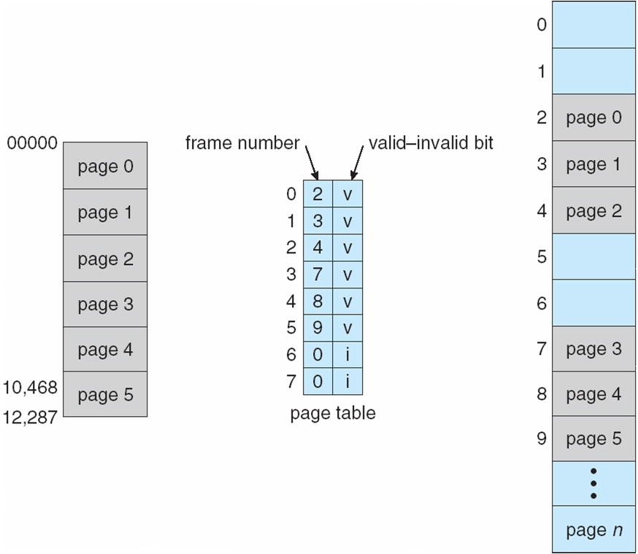
Valid (v) or Invalid (i) Bit In A Page Table

Slide 137
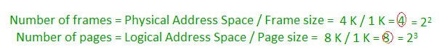
Structure of the Page Table
Memory structures for paging can get huge using straight-forward methods
Consider a 32-bit logical address as on modern computers=Logical Address Space=2³²
Page size of 4 KB (2¹²)
Page table would have 1 million entries =2³² / 2¹²
If each entry is 4 bytes -> 4 MB of physical address space / memory for page table alone
That amount of memory used to cost a lot
We would not want to allocate the page table contiguously in main memory

Slide 138
Structure of the Page Table
One simple solution to this problem is to divide the page table into smaller pieces.
Hierarchical Paging
Hashed Page Tables
Inverted Page Tables

Slide 139
Hierarchical Page Tables
Break up the logical address space into multiple page tables
A simple technique is a two-level page table
We then page the page table

Slide 140
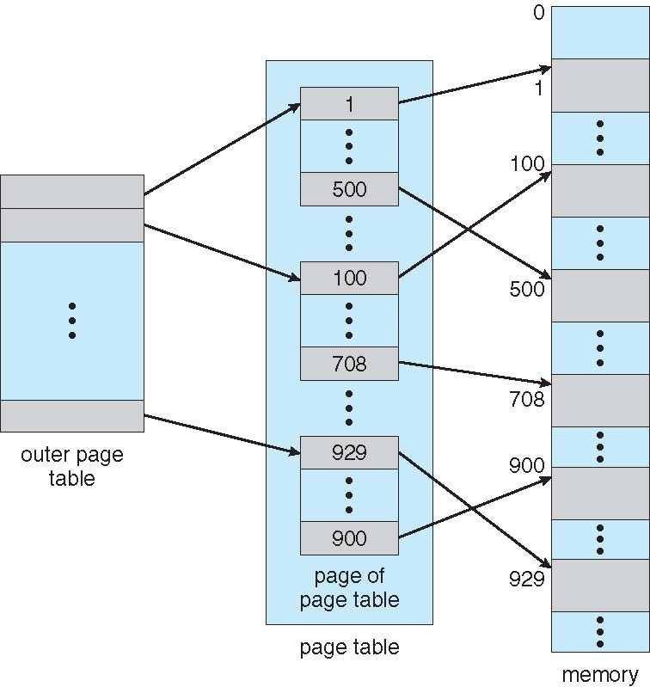
Two-Level Page-Table Scheme
Admin=>Dept=>
ClassNo=>Seat No in Class

Slide 141
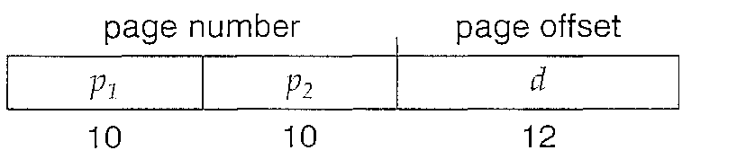
Two-Level Paging Example
A logical address (on 32-bit machine with 1K page size) is divided into:
a page number consisting of 20 bits
a page offset consisting of 12 bits
Since the page table is paged, the page number is further divided into:
a 10-bit page number
a 10-bit page offset
Thus, a logical address is as follows:

Slide 142
Two-Level Paging Example
Thus, a logical address is as follows:
where
p₁ is an index into the outer page table,
p₂ is the displacement within the page of the outer page table
Because address translation works from the outer page table inward, this scheme is also known as forward-mapped page table

Slide 143
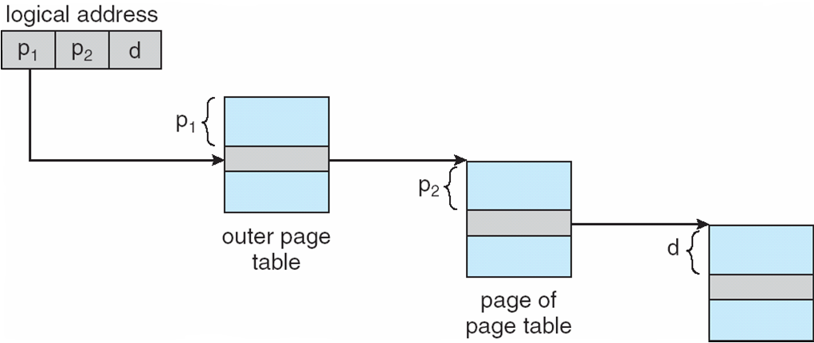
Address-Translation Scheme

Slide 144

64-bit Logical Address Space
Even two-level paging scheme not sufficient
Logical Address Space= 2⁶⁴
If page size is 4 KB (2¹²)
No of pages=2⁶⁴/2¹²= 2⁵²
Then page table has 2⁵² entries
If two level scheme, Address would look like
Outer page table has 2⁴² entries or 2⁴⁴ bytes

Slide 145
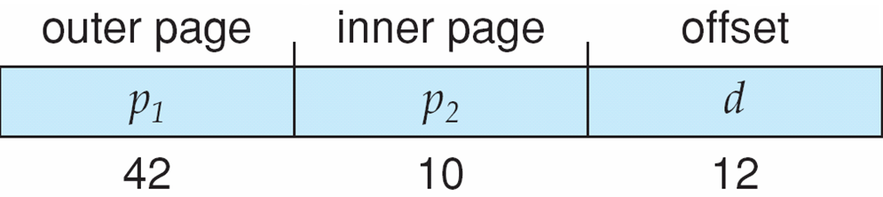
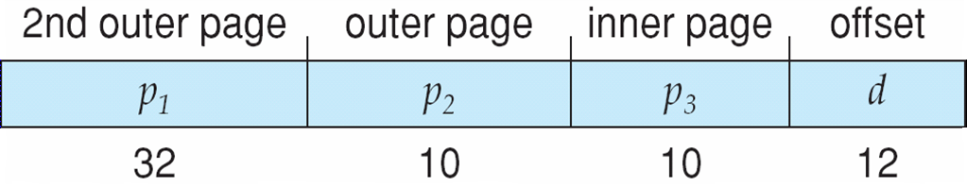
Three-level Paging Scheme
One solution is to add a 2nd outer page table
The outer page table is still 2³² bytes in size.
The next step would be a four-level paging scheme, where the second-level outer page table itself is also paged, and so forth.

Slide 146
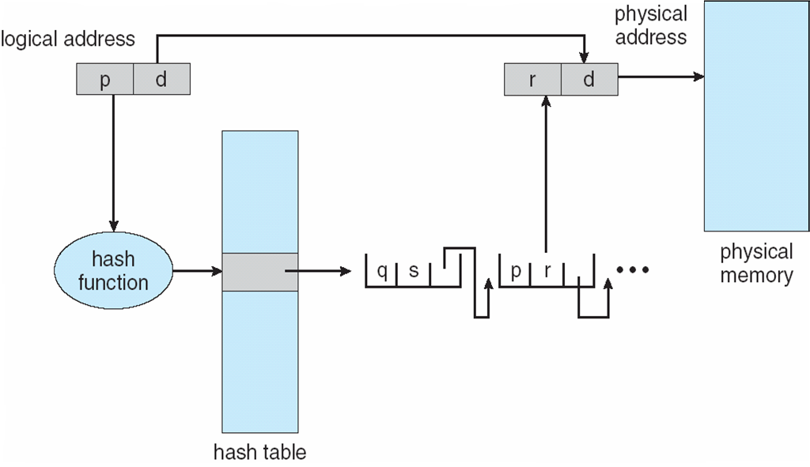
Hashed Page Tables
Common in address spaces > 32 bits
The virtual page number is hashed into a page table
Each entry in the hash table contains a linked list of elements that hash to the same location (to handle collisions).
Each element consists of three fields:
(1) the virtual page number,
(2) the value of the mapped page frame, and
(3) a pointer to the next element in the linked list.

Slide 147
Hashed Page Tables
The algorithm works as follows:
The virtual page number in the virtual address is hashed into the hash table.
The virtual page number is compared with field 1 in the first element in the linked list.
If there is a match, the corresponding page frame (field 2) is used to form the desired physical address.
If there is no match, subsequent entries in the linked list are searched for a matching virtual page number.

Slide 148
Hashed Page Table

Slide 149
Inverted Page Table
Rather than each process having a page table and keeping track of all possible logical pages, track all physical pages
One entry for each real page(frame) of memory
Entry consists of the virtual address of the page stored in that real memory location, with information about the process that owns that page
Thus, only one page table is in the system, and it has only one entry for each page(frame) of physical memory.

Slide 150
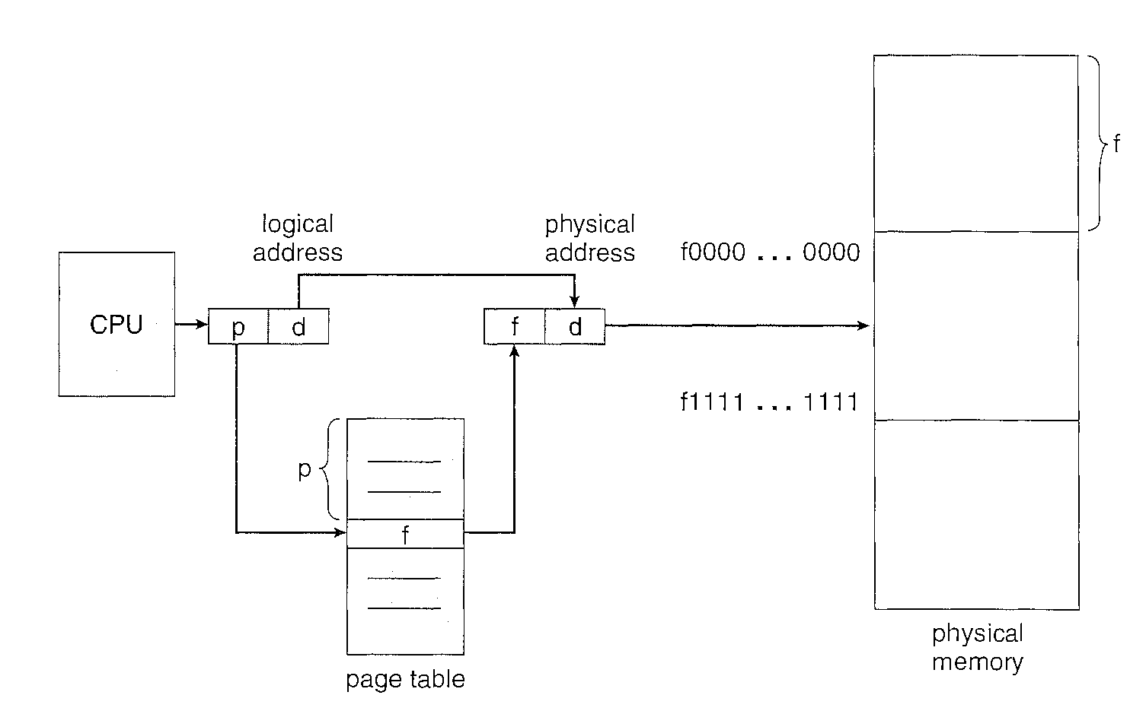
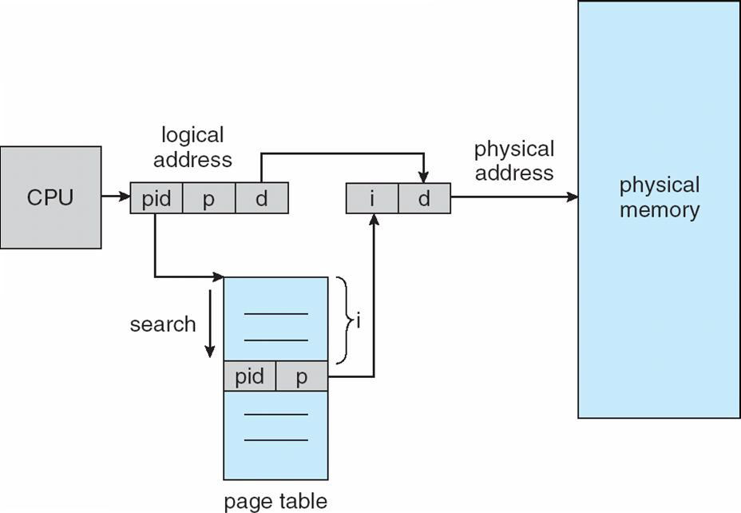
Inverted Page Table Architecture

Slide 151
Inverted Page Table Architecture
Each virtual address in the system consists of a triple:
<process-id, page-number, offset>
When a memory reference occurs, part of the virtual address, consisting of <process-id, pagenumber> is presented to the memory subsystem.
The inverted page table is then searched for a match.
If a match is found-say, at entry i-then the physical address <i, offset> is generated.
If no match is found, then an illegal address access has been attempted.

Slide 152
Segmentation
Memory-management scheme that supports user view of memory
A program is a collection of segments
A segment is a logical unit such as:
main program
procedure
function
method
object
local variables, global variables
common block
stack
symbol table
arrays

Slide 153
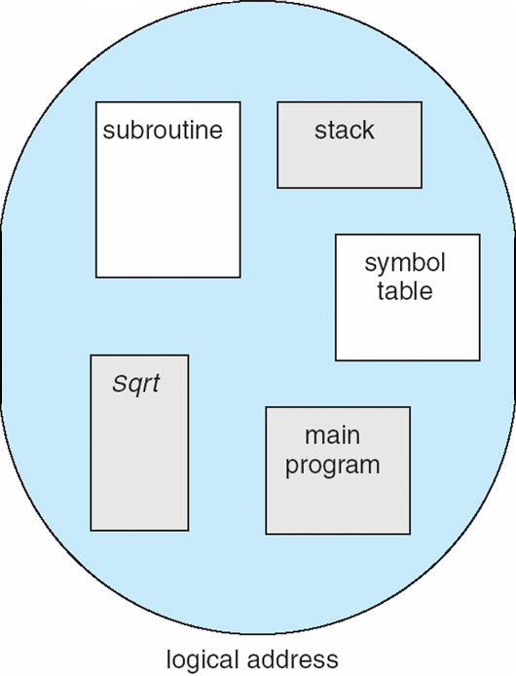
User’s View of a Program
A logical address space is a collection of segments.
Each segment has a name and a length.
The addresses specify both the
segment name and
the offset within the segment.

Slide 154
Logical View of Segmentation
1
1
4
2
3
4
2
3
user space
physical memory space

Slide 155
Segmentation Architecture
Segments are numbered and are referred to by a segment number, rather than by a segment name.
Logical address consists of a two tuple:
<segment-number, offset>,

Slide 156
Segmentation Architecture
Normally, the user program is compiled, and
The compiler automatically constructs segments reflecting the input program.
A C compiler might create separate segments for the following:
The code
Global variables
The heap, from which memory is allocated
The stacks used by each thread
The standard C library

Slide 157
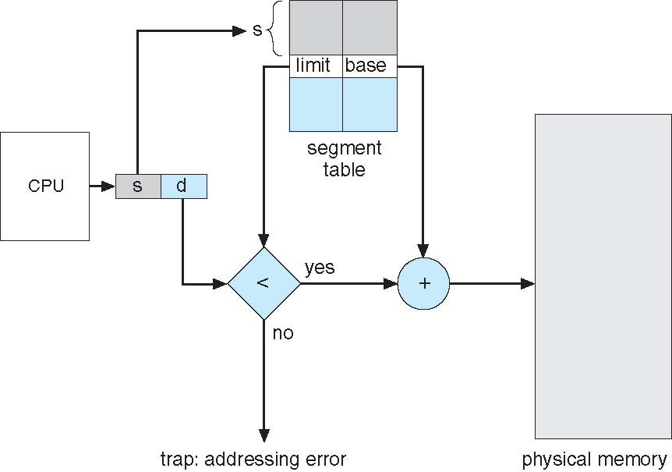
Segmentation Hardware

Slide 158
Segmentation Hardware
Segment table – maps two-dimensional physical addresses; each table entry has:
base – contains the starting physical address where the segments reside in memory
limit – specifies the length of the segment

Slide 159
Segmentation Hardware
The segment number is used as an index to the segment table.
The offset d of the logical address must be between 0 and the segment limit.
If it is not, we trap to the operating system (logical addressing attempt beyond end of segment).

Slide 160
Segmentation Hardware
When an offset is legal, it is added to the segment base to produce the address in physical memory of the desired byte.
The segment table is thus essentially an array of base-limit register pairs.

Slide 161
Segmentation Hardware
Segment-table base register (STBR) points to the segment table’s location in memory
Segment-table length register (STLR) indicates number of segments used by a program;
segment number s is legal if s < STLR

Slide 162
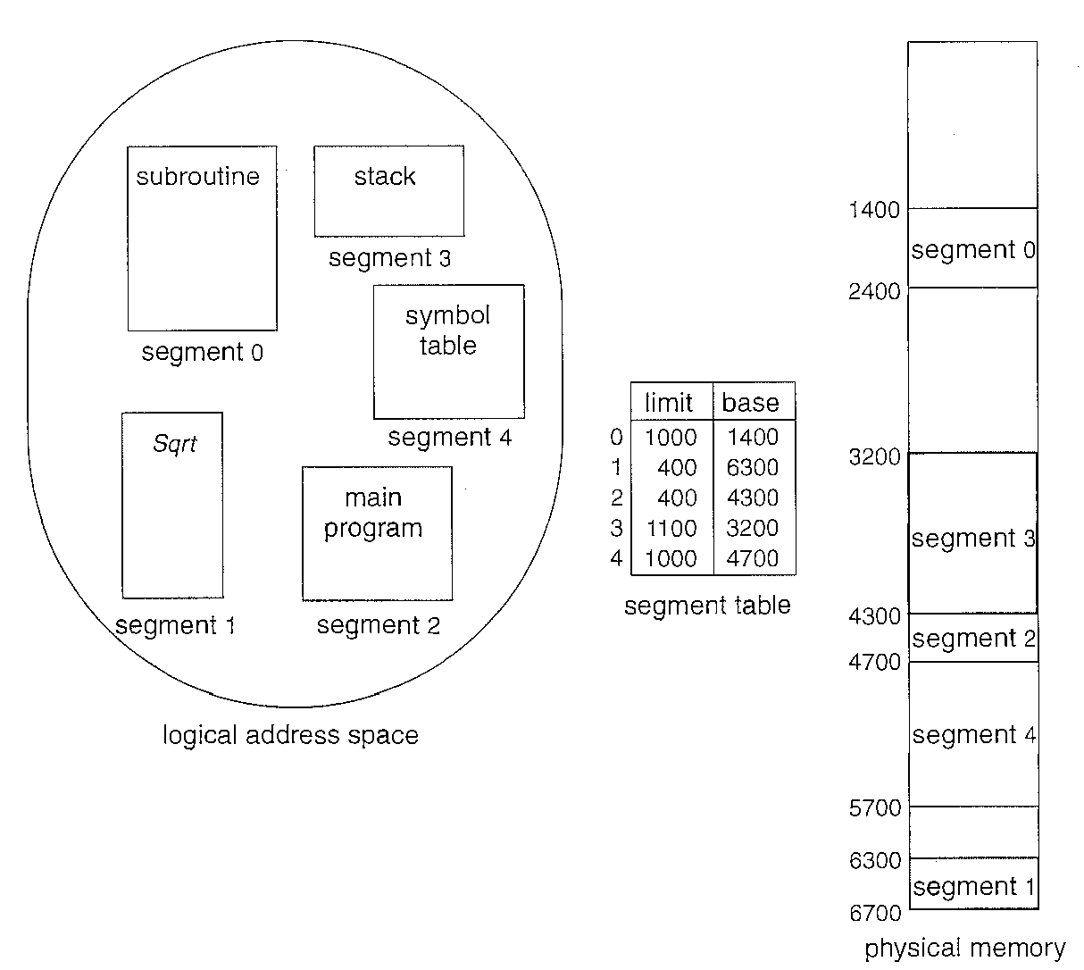
Segmentation Example
We have five segments numbered from 0 through 4.
The segments are stored in physical memory as shown.
The segment table has a separate entry for each segment, giving the beginning address of the segment in physical memory or base) and the length of that segment (or limit).

Slide 163
Segmentation Example
Segment 2 is 400 bytes long and begins at location 4300. Thus, a reference to byte 53 of segment 2 is mapped onto location 4300 +53= 4353.

Slide 164
Segmentation Example
A reference to segment 3, byte 852, is mapped to 3200 (the base of segment 3) + 852 = 4052.
A reference to byte 1222 of segment 0 would result in a trap to the operating system, as this segment is only 1OOO bytes long.

Slide 165
Example: The Intel 32 and 64-bit Architectures
Dominant industry chips
Pentium CPUs are 32-bit and called IA-32 architecture
Current Intel CPUs are 64-bit and called IA-64 architecture
Many variations in the chips, cover the main ideas here

Slide 166
Example: The Intel IA-32 Architecture-Segmentation with Paging
Supports both segmentation and segmentation with paging
Each segment can be 4 GB
Up to 16 K segments per process
Divided into two partitions
First partition of up to 8 K segments are private to process (kept in local descriptor table (LDT))
Second partition of up to 8K segments shared among all processes (kept in global descriptor table (GDT))

Slide 167
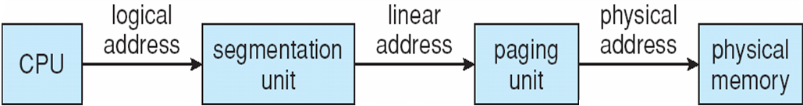
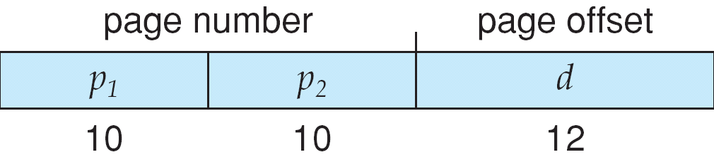
Logical to Physical Address Translation in IA-32
The CPU generates logical addresses, which are given to the segmentation unit.
The segmentation unit produces a linear address for each logical address.
The linear address is then given to the paging unit, which in turn generates the physical address in main memory.
Thus, the segmentation and paging units form the equivalent of the memory-management unit (MMU).

Slide 168

Example: The Intel IA-32 Architecture (Cont.)
CPU generates logical address
Selector given to segmentation unit
Which produces linear addresses
Linear address given to paging unit
Which generates physical address in main memory
Paging units form equivalent of MMU
Pages sizes can be 4 KB or 4 MB

Slide 169
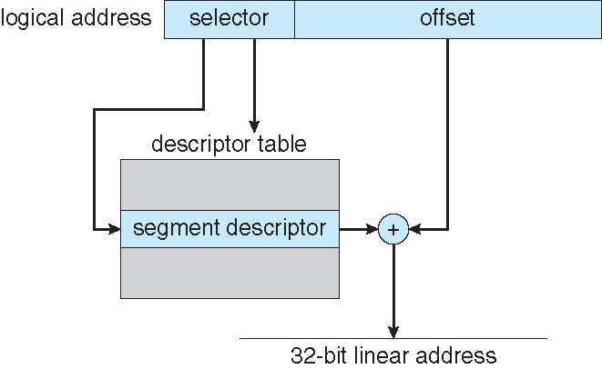
Intel IA-32 Segmentation

Slide 170
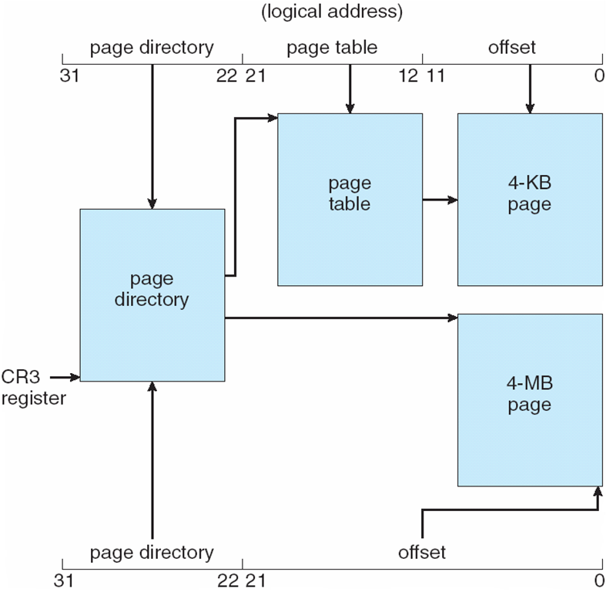
Intel IA-32 Paging Architecture

Slide 171
Intel IA-32 Page Address Extensions
32-bit address limits led Intel to create page address extension (PAE), allowing 32-bit apps access to more than 4GB of memory space
Paging went to a 3-level scheme
Top two bits refer to a page directory pointer table
Page-directory and page-table entries moved to 64-bits in size
Net effect is increasing address space to 36 bits – 64GB of physical memory

Slide 172
Intel x86-64
Current generation Intel x86 architecture
64 bits is ginormous (> 16 exabytes)
In practice only implement 48 bit addressing
Page sizes of 4 KB, 2 MB, 1 GB
Four levels of paging hierarchy
Can also use PAE so virtual addresses are 48 bits and physical addresses are 52 bits

Slide 173
Shared Pages
Shared code
One copy of read-only (reentrant) code shared among processes (i.e., text editors, compilers, window systems)
Similar to multiple threads sharing the same process space
Also useful for interprocess communication if sharing of read-write pages is allowed
Private code and data
Each process keeps a separate copy of the code and data
The pages for the private code and data can appear anywhere in the logical address space

Slide 174
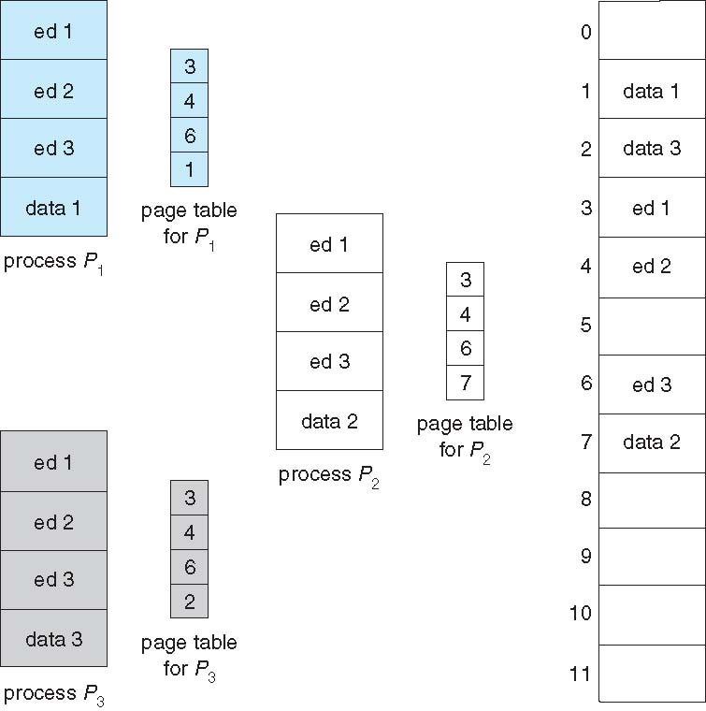
Shared Pages Example

